Slide 1
Data Visualization Best Practices Part 1
Brian Seko, March 2022

Slide 2
A Visual Should be…
Effective
Delivering the facts better than any other method
Expressive
Show all the facts, and only the facts (relevant facts…)
Notes:
When it comes to talking about visuals, two tenants should always be followed: a chart should be both expressive and effective. If you achieve this, any visualization you create will accomplish your goals.

Slide 3
Visual Standards
 | Quantitative | Ordinal | Nominal
Continuous | Scatterplot Histogram | Line Chart Area Chart | Bar Chart Stacked Bar Grouped Bar Pie Chart
Discrete | Histogram | Bar Chart Stacked Bar Grouped Bar

Slide 4
Visual Standards
 | Quantitative | Ordinal | Nominal
Continuous | Color Saturation | Saturation | Color
Discrete |  | Position Color | Color /Texture

Slide 5



Do
Limit the number of variables you visualize
Embrace whitespace
Reduce visual complexity
Use connections when content is related (e.g., timeseries)
Try to Avoid
Pie charts – limit to 2-3 comparisons if they must be used
Comparing charts on the same slide
Overlaying visualizations
Overlaying data with different scales
Don’t
Create needless variety
Use cultural meaning out of context (e.g., green = bad, red = good)
Use of 3D charts, just don’t use them
Truncate your axis

Slide 6
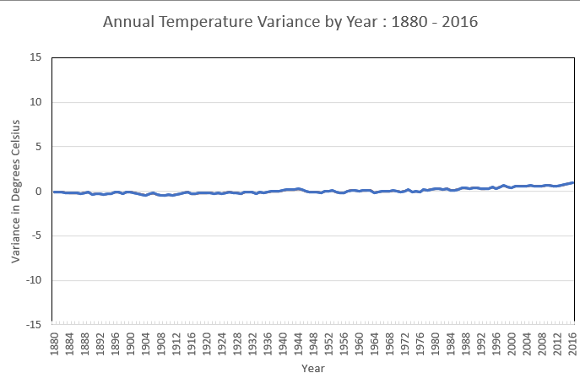

Slide 7
